Slide 1
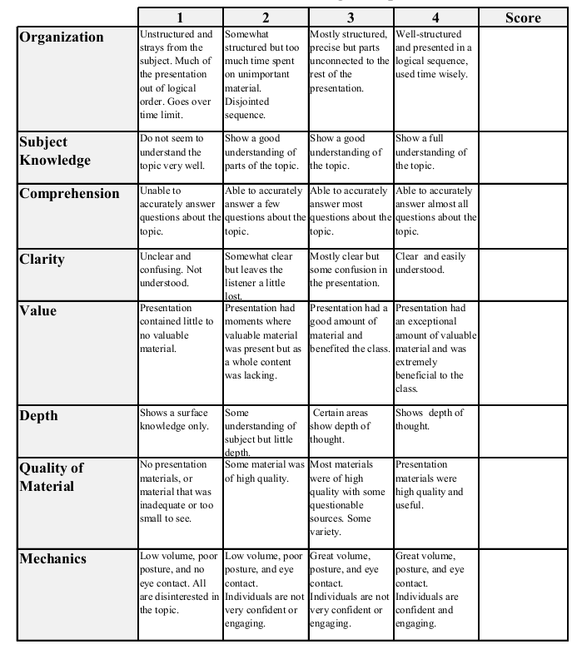
Fall 2014: Econ 339 Final Presentation
Timothy Szivos
December 2, 2014
Long-run labor market and health effects of individual sports activities
Reference: Michael Lechner (2009), Title of presentation, Journal of Health Economics, Vol. 28, Issue 4, p.839-54
Total:_________

Slide 2
Introduction
Known possible effects of individual participation in leisure time sports on individual long-run labor market outcomes.
Improved health and individual well-being
Social networking effects
Signal potential employers that individuals enjoy good health, are motivated
Purposes of the research article.
Learn more about the correlates of sports activities by using data with its wealth of information.
Uncover the long run effects of participation in sports on labor market success and several other socio-demographic and health variables.

Slide 3
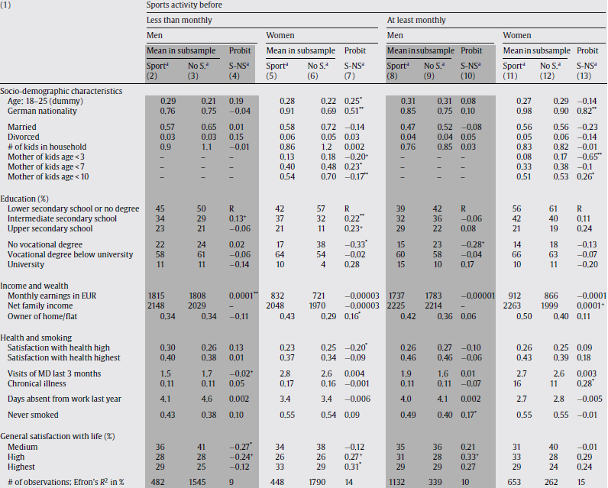
Descriptive statistics and of the selection process into sports activities.
The ‘no-sports sample’ consists of individuals with less than monthly participation in sports activities in the year before their decision is analyzed. The sports sample is made up of individuals participating in sports activities more frequently.

Slide 4
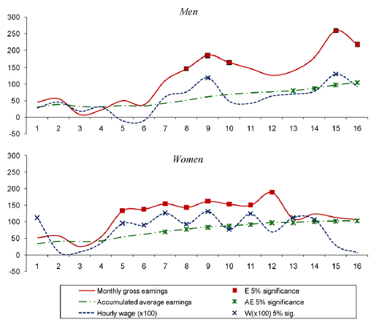
Leisure sports effect on earnings
Effect of sports activity on earnings. Monthly gross earnings are measured as gross earnings in the month before the interview. Accumulated average earnings are monthly earnings summed up year by year until the year in question divided by the number of valid interviews up to the respective year.

Slide 5
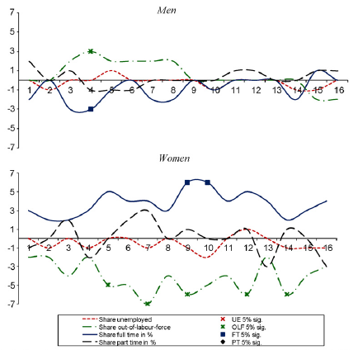
Leisure sports effect on employment
Effect of sports on employment status. Effects are changes in the shares of the different employment categories (% points).

Slide 6
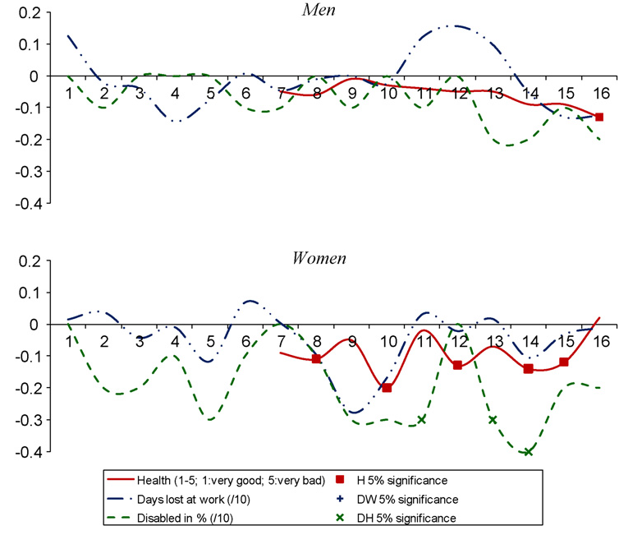
Leisure sports effect on health
Effects of sports participation on health. All health indicators are defined such that a negative value implies that sports participation led to an improved health situation. The general health measure is only available beginning with period 7.

Slide 7
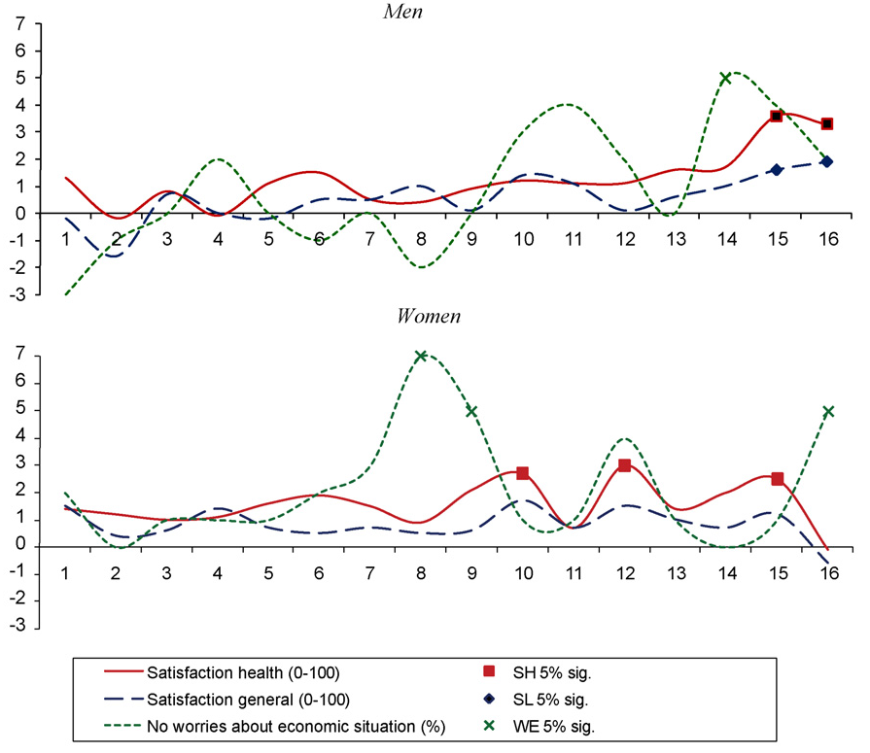
Leisure sports effect on satisfaction
Effects of sports participation on satisfaction with life and health and worries about the economy. Note: Effects of sport participation at least monthly for individuals who are active in the decision period.

Slide 8
Conclusion
The analysis of the effects of sports activities on outcomes revealed sizeable labor market effects.
Active sports increase earnings by approximately 1200 EUR ($1500) a year and 22000 EUR ($30000) over a 16 year span compared to no or very low activities.
These results translate into returns in the range of 5-10%, which is similar to the magnitude of one addition year of schooling.
Increased health and improved well-being in general seem to be relevant channels to foster these gains in earnings.
Women probability of full-time employment increase and unemployment decrease.

